Slide 1
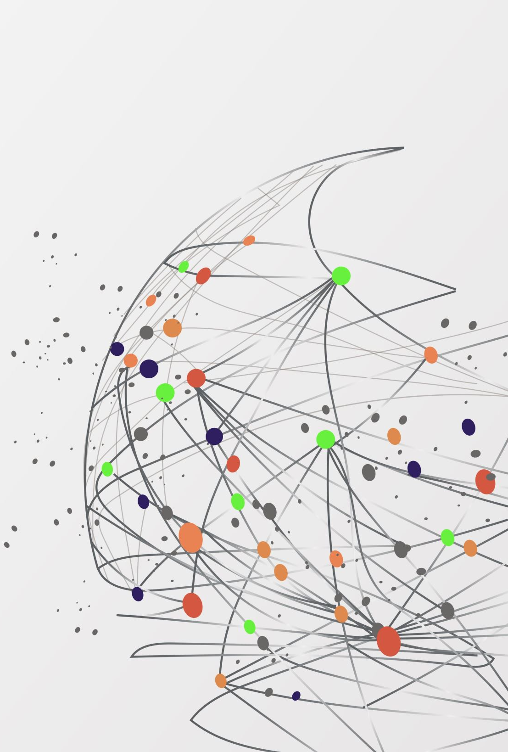
Group Project 2
Group Members: Issa Habeeb, Ali Algahim, Emran Ali, George Ebaugh, Munassar Shariff, Nadia Aktar, Rasheed Kareem

